Slide 1

Smart Delivery Box
IoT Project
Group Members
Usama Azhar
Ayesha Ali
Abdul Wahab

Slide 2
Table of Content
Smart Delivery Box
Conceptual Design
Features of the Project
Software Flow
Hardware Requirements
Task Distribution and Timeline of Project

Slide 3
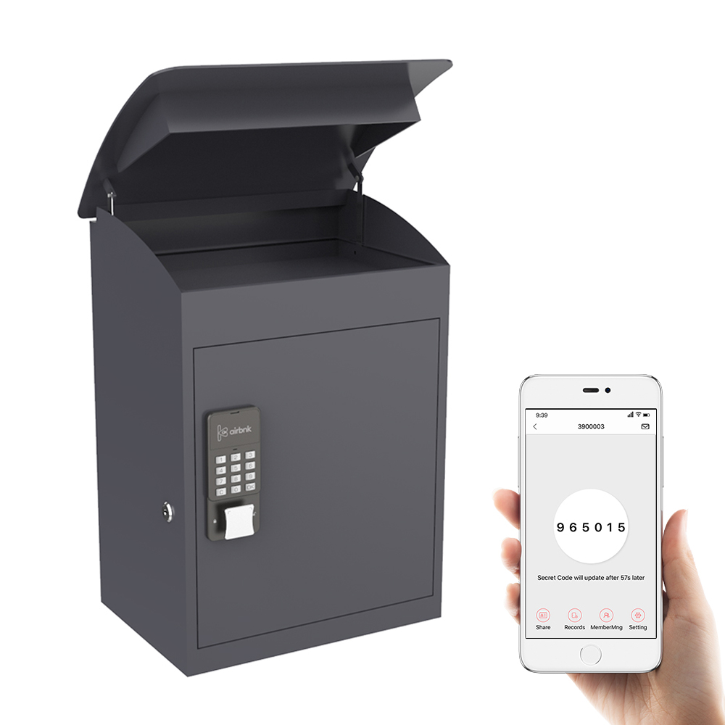
Smart Delivery box
Smart delivery box is a secure letter box with
user feedback and control via server.
It provides secure and real time tracking
of the parcel.
Can be monitored on users app and
companies' main server.

Slide 4
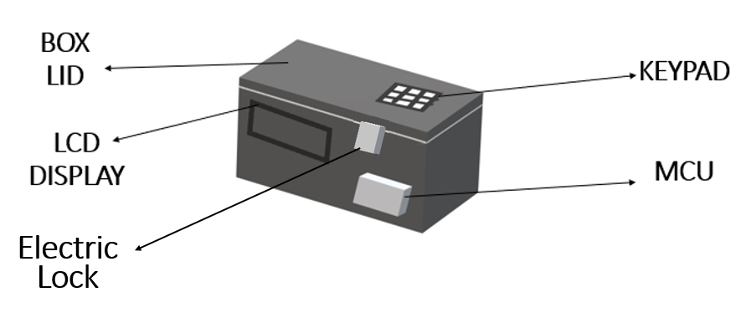
Conceptual design

Slide 5
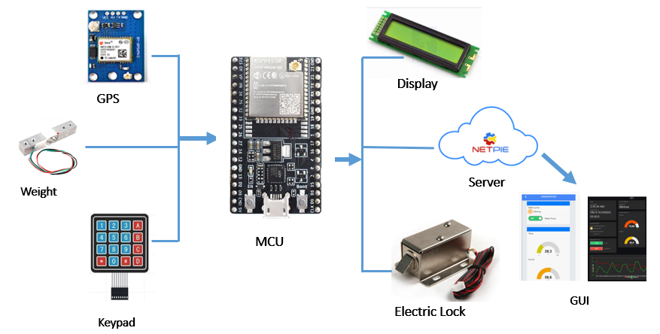
Conceptual design

Slide 6
Features (1/4)
The key features of the project includes
Real time location tracking through internet connectivity.
Password protected lock system implementation.
Mobile app for control

Slide 7
Features (2/4)
Real time location tracking
GPS module in delivery box to fetch location data.
Internet connectivity for location data transfer to server.
GSM (3G) connection during transit and unviability of Wi-Fi.
Data transfer to cloud server after every x-time interval.
GPS location with accuracy --------.

Slide 8
Features (3/4)
Lock System
Electric lock operated using MCU controlled switches.
Password implementation in software algorithm.
Unlock from user input from keypad.
Unlock from app.
Update server with lock status.
Max number of wrong attempts detection and disable unlock.
App notifications and warnings.

Slide 9
Features (4/4)
Mobile app control
Control of lock system
Providing real time tracking
Display
LCD display for user instruction.
Location and status information on Display.
Hex keypad for password and user input.

Slide 10
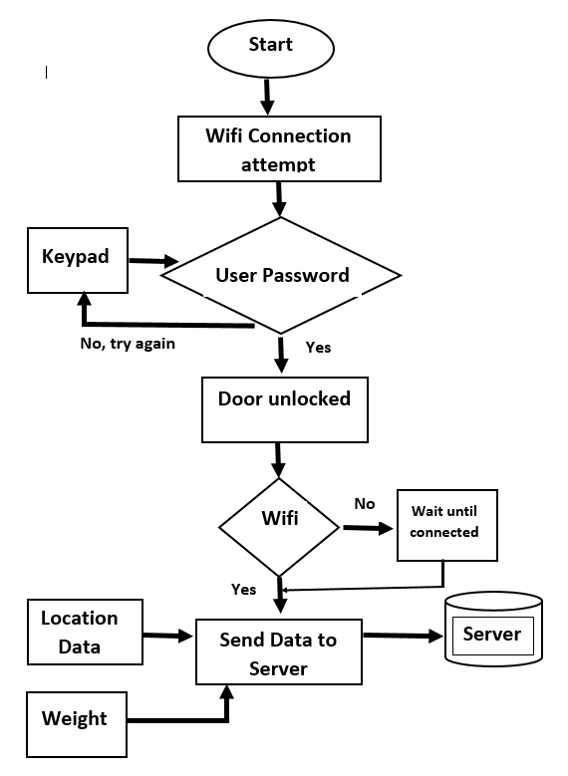
Software Flow 1/2

Slide 11
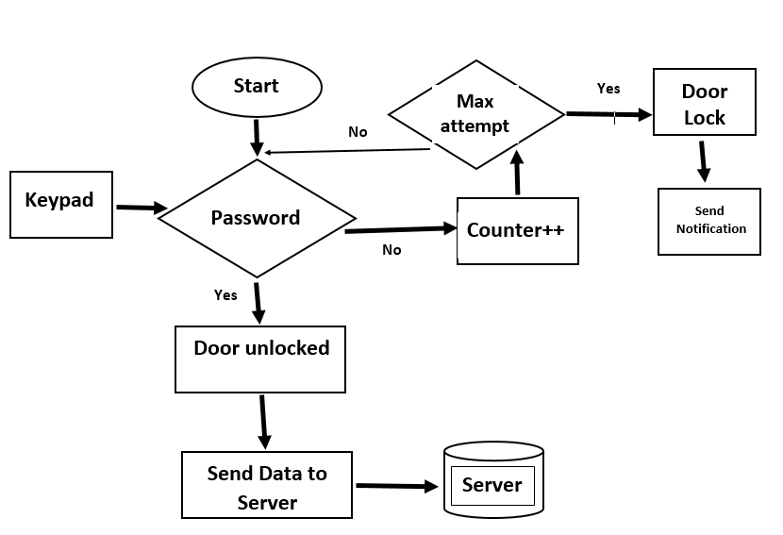
Software Flow 2/2

Slide 12
Hardware
The main hardware components used in project are
MCU: ESP32
Location (GPS): GPS Module NEO 6M
Connectivity: ESP32 built-in Wi-Fi & GSM Module SIM800L
Display: 16*2 LCD
Keypad: Hex Keypad
Electric Lock: Servo Motor
Weight: Half Bridge Load HX711

Slide 13
Task distribution
Ayesha Ali
Real time location tracking through GPS {SW A1.1}
Real time location tracking through GSM {SW A1.2}
Hardware Configuration: ESP32, SIM800L and LCD 16*2 {HW A1.1}
Usama Azhar (real time tracking)
Mobile app control {SW B1.1}
Display of information on box {SW B1.2}
Hardware Configuration: ESP32 & GPS Module NEO 6M {HW B1.1}
Abdul Wahab (lock system)
Electric lock operated using MCU controlled switches, through app and keypad {SW C1.1}
Max number of wrong attempts detection and disable unlock. SW C1.2}
Update Server and app notifications and warnings {SW C1.3}
Hardware Configuration: ESP32, Hex Keypad & Half Bridge Load Cell HX711 {HW C1.1}

Slide 14
Task distribution w.r.t. timeline
 | Week 1 | Week 2 | Week 3 | Week 4 | Week 5 | Week 6 | Week 7 | Week 8
HW A1.1
SW A1.1 Internet Connectivity
SW A1.2 Display
HW B1.1
SW B1.1 Location
SW B1.2 Server
HW C1.1
SW C1.1 Keypad
SW C1.2 Lock
SW C1.3 Weight

Slide 15
Thank YOU!

